Slide 1

BCDSS – SME Meeting
May 20, 2016

Slide 2
BCDSS – SME Meeting Attendance
Office SME |  | Name |  | Attendance
Veteran Health Administration Innovations Program
Innovation Coordinator | Brian Stevenson
Innovation Coordinator | Heath A. Forney |  | *
OSP Liaison | Edward L Wells
Product Owner | Elizabeth Wollin |  | *
OBPI Representative | Kaitlin Conron
OBPI Representative | Matthew Padula |  | *
SME | Paul J Shute |  | *
SME | VILAYPHONG SENTHEP |  | *
OBPI Representative | Karla Leal
Pro Sphere (BCDSS) | Bhupinder Pal. Singh |  | *
Pro Sphere (BCDSS) | Chiranjeevi Puttaswamy |  | *
Pro Sphere (BCDSS) | Darrell Dorman |  | *
PWS (BCDSS) | David Teague |  | *
Pro Sphere (BCDSS) | Dominic Yeh |  | *
Pro Sphere (BCDSS) | Erik Rothwell |  | *
Pro Sphere (BCDSS) | Ganesh Panneer |  | *
Pro Sphere (BCDSS) | Jeffrey Bamba
Pro Sphere (BCDSS) | Rebecca Garcia DeJesus |  | *
Pro Sphere (BCDSS) | Vasudeva Rayapati |  | *

Slide 3
BCDSS – SME Meeting Agenda
Discussions from previous meeting
Exceptions Analysis for Ear Related Supplemental Claims
Wireframes related to Rater’s Dashboard - CJ
Questions

Slide 4
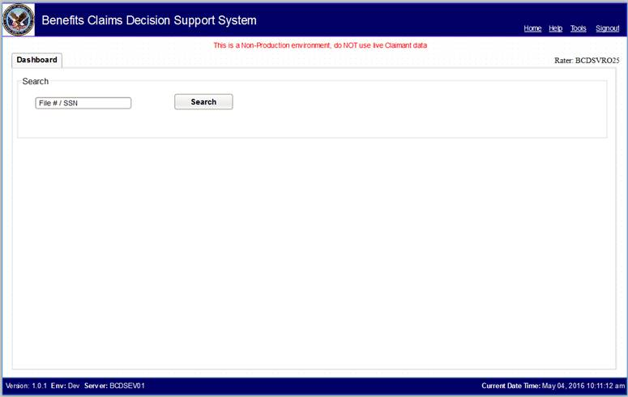
BCDSS – SME Meeting Wireframes – Rater’s Dashboard

Slide 5
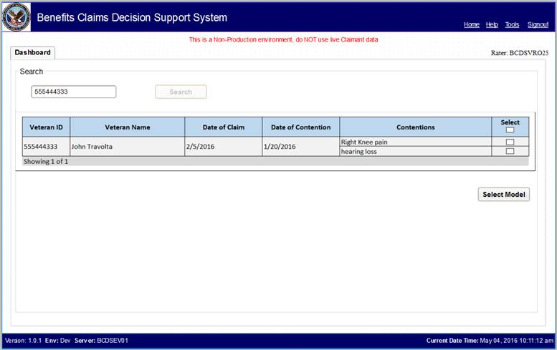
BCDSS – SME Meeting Wireframes – Rater’s Dashboard

Slide 6
BCDSS – SME Meeting Action Items
Action Items from 04/29/2016
CJ/Ganesh to share the updated Epics and User stories with Elizabeth and team – Sent the updated RTM
CJ/Ganesh to come up with the plan for the upcoming Story board discussion for the next SME call – CJ is meeting with Elizabeth on a regular basis
Action Items from 05/06/2016
David will put together the details of this specific situation and sent out to Elizabeth so that we can reach the right audience to discuss the possible use case – Initial draft is with Elizabeth
David will also send out the possible timeframe on 2012 - when this started happening - done
David will also send out the Logical grouping - of diagnostics code and possibly convey which groups occur most common – Sent to Matt and Paul
Action Items from 05/20/2016
Date of Contention – should be addressed in a different way

Slide 7
BCDSS – SME Meeting Questions
?

Slide 8
BCDSS – SME Meeting
Thank you!

